Slide 1
Binomial Queues
By Abdul Imran
&
Manny Negrete

Slide 2
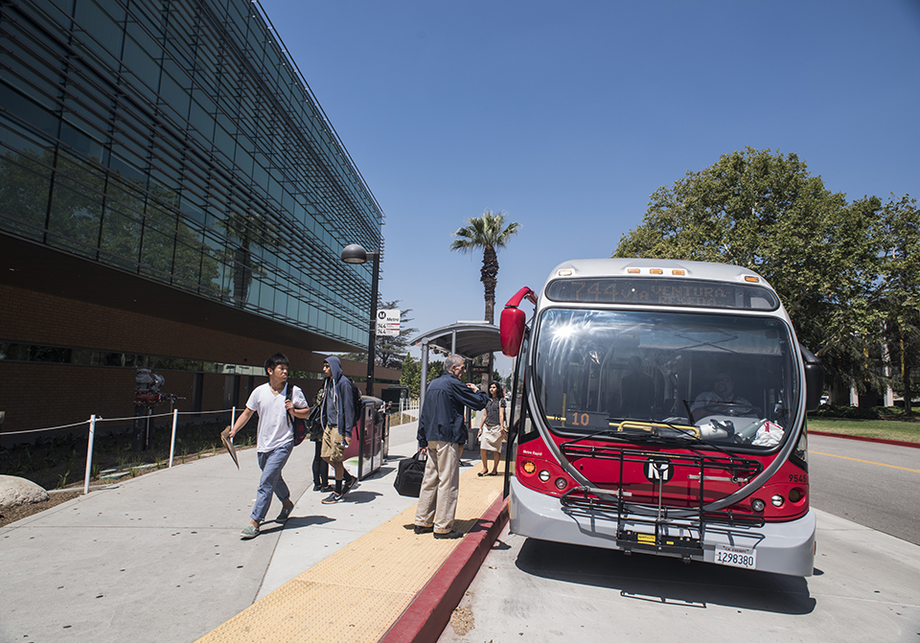
CSUN Shuttle Prioritizations
Core Algorithms
Unlock Efficiency
Prioritizing Passenger Loads

Slide 3






What are Binomial Queues?

Slide 4
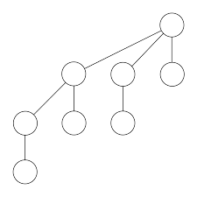
Understanding Binomial Trees
Before we can look at Binomial Queues, we must first look at Binomial Trees
Definition: A binomial tree is a special type of tree structure used in computer science and mathematics.
Hierarchy of Ranks: Binomial trees are organized based on ranks, where each rank represents a level in the tree, and each tree of a particular rank satisfies specific properties.
Properties: Each binomial tree of rank k has 2^k nodes, and there is precisely one tree of each rank in a binomial heap.
The nodes in a binomial tree are organized in a way that maintains the structure of a binary tree.
Family of Trees: Binomial trees often work together as a family, forming a binomial heap, which is a collection of binomial trees with specific relationships.
[1]

Slide 5
Intro to Binomial Heaps
Now that we covered what Binomial Trees are, we can move to Binomial Heaps
A binomial heap is a collection of binomial trees that follows specific rules and properties.
Min heap trees
Key operations in binomial heaps include insertion, extraction of the minimum element, and union
[2]

Slide 6
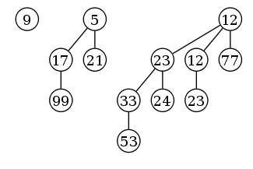
Binomial Queues
Based on binomial trees and binomial heaps
A type of priority queue data structure
Efficient insertion and deletion of elements
[1]

Slide 7

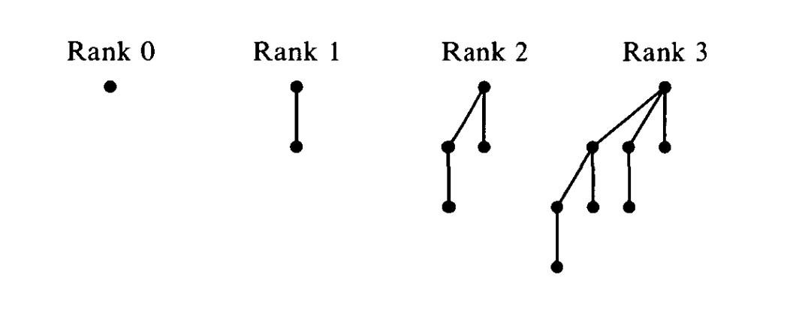
Binomial Queues
Binomial Queue with ranks from 0 to 3
# of Elements
[2]

Slide 8
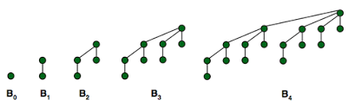
Building Binomial Queues
A binomial queue consisting of six elements with two binomial trees B1 and B2
Elements: A set of binomial trees.
Ordering: Ordered by the height of the trees.
Operations: Union, Insertion, Extraction of the Minimum.
[3]

Slide 9
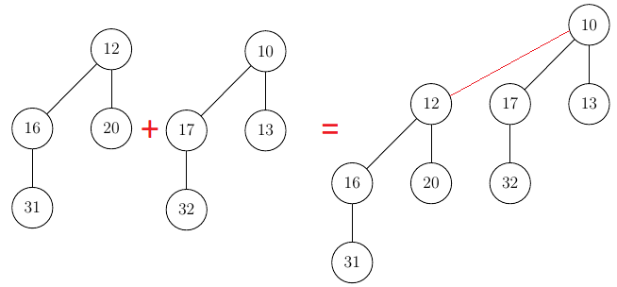
Merging Binomial Queues
Union Operation: Combining two binomial queues.
Steps:
1. Merge binomial trees of the same order.
2. Carry over any "extra" tree.
3. Repeat until there is no carry.
[3]

Slide 10
Adding Elements to Binomial Queue
Insertion Operation: Adding an element to the binomial queue.
Steps:
1. Create a new binomial queue with a single tree.
2. Perform union operation with the original queue.

Slide 11
Removing the Minimum Element
Extract Min Operation: Removing the tree with the minimum root value.
Steps:
1. Find the tree with the minimum root.
2. Remove the tree.
3. Create a new binomial queue with the removed tree's children.
4. Union the new queue with the original queue.

Slide 12
Applications
Where Binomial Queues Shine
Dijkstra's Algorithm: Efficient implementation of the priority queue.
Mergeable Heaps: Useful in algorithms involving merging of heaps.
Optimal Merge Patterns: Applications in external sorting.

Slide 13
Dataset:
Where did you collect the dataset?
What are characteristics of the samples?
Distribution Across Hours: The samples are distributed across the time slots from 8 am to 9 pm.
Location Preference: Majority of the students have their classes in Jacaranda Hall. Other halls where classes were held include Cypress Hall, Live Oak Hall, Magnolia Hall, Bayramian Hall, Valera Hall, Chaparral Hall, Eucalyptus Hall, and Sierra Hall.
Number of Classes: Each respondent has a varying number of classes throughout the day.

Slide 14




Dataset that shows which halls students have class in broken down by 1 hour increments
Time/Hall | Jacaranda Hall | Chaparral Hall | Bayramian Hall | Cypress Hall | Live Oak Hall | Magnolia Hall | Valera Hall | Eucalyptus Hall | Sierra Hall
8 am | 3 | 0 | 0 | 1 | 0 | 1 | 0 | 0 | 0
9 am | 3 | 4 | 1 | 0 | 1 | 1 | 1 | 0 | 0
10 am | 5 | 0 | 2 | 2 | 4 | 0 | 0 | 1 | 0
11 am | 5 | 2 | 0 | 2 | 1 | 1 | 0 | 0 | 1
12 pm | 5 | 0 | 1 | 0 | 0 | 0 | 1 | 0 | 1
1 pm | 9 | 0 | 0 | 4 | 2 | 1 | 0 | 1 | 1
2 pm | 7 | 1 | 2 | 2 | 2 | 0 | 2 | 0 | 1
3 pm | 3 | 0 | 0 | 3 | 1 | 3 | 2 | 0 | 1
4 pm | 5 | 0 | 1 | 1 | 2 | 2 | 1 | 0 | 0
5 pm | 0 | 1 | 1 | 0 | 1 | 0 | 0 | 0 | 0
6 pm | 0 | 1 | 0 | 0 | 1 | 1 | 0 | 0 | 0
7 pm | 2 | 0 | 0 | 1 | 1 | 0 | 0 | 1 | 1
8 pm | 1 | 0 | 1 | 0 | 0 | 0 | 0 | 0 | 0
9 pm | 1 | 0 | 0 | 0 | 0 | 0 | 0 | 0 | 0

Slide 15
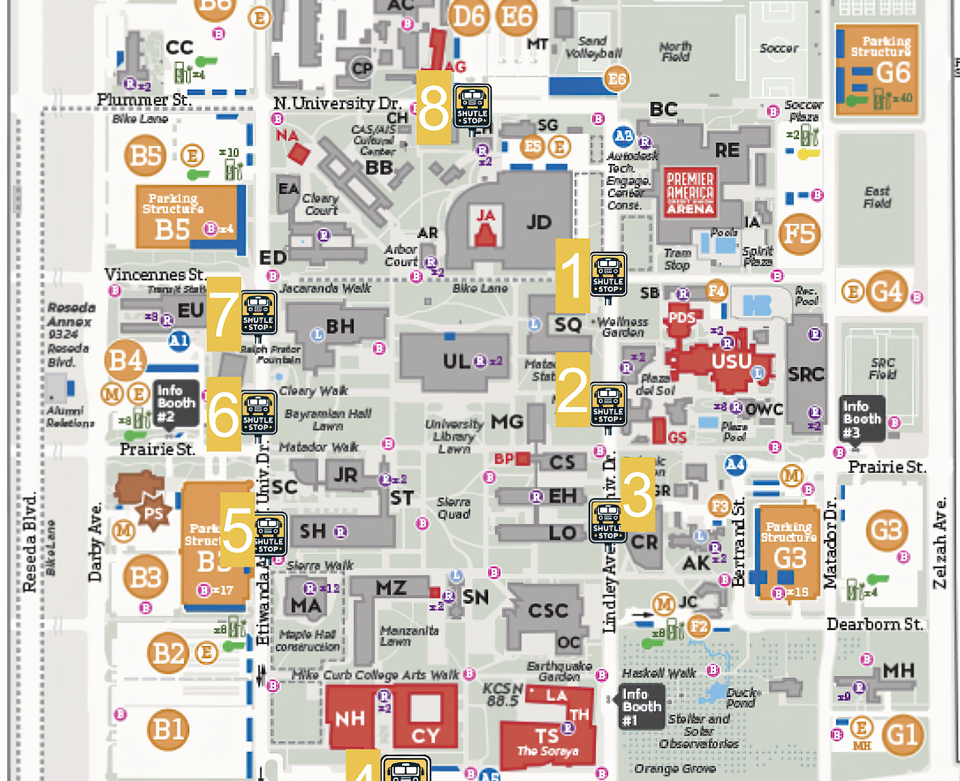
Shuttle Stops
*Figure depicts a CSUN campus map with marked shuttle stops, numbered in the order the shuttle will travel to them
Map displays designated shuttle stops.
Shuttle route: Stop 1 through Stop 8.
Arrival frequency: Approximately once an hour.
Boarding time: 3-10 minutes (varies based on student count).
[4]

Slide 16
Methodologies/algorithms:
Binomial Queues were utilized to streamline and optimize shuttles
Other key algorithms/data structures
Linkedlists
Heap Operations
Node Reversals (aka node deletion)

Slide 17
Pseudocode
Binomial Queue:
# Create a ShuttleScheduler instance for scheduling shuttle stops
scheduler = new ShuttleScheduler<ShuttleStop>()
# Define halls with varying passenger loads
hallname = new Hall("hallname", #number of students)
cypressHall = new Hall("Cypress Hall", 50)
# Create shuttle stops based on the halls they serve
stop1 = new ShuttleStop(1)
stop1.addHall(hallname)
# Insert shuttle stops into the scheduler
scheduler.insert(stop1)
# Send shuttles to stops with the most passengers first
while not scheduler.isEmpty():
maxStop = scheduler.deleteMax()
print("Sending shuttle to: " + maxStop)?
Binary Search Tree:
# Create a ShuttleScheduler instance for scheduling shuttle stops using a Binary Search Tree
scheduler = new ShuttleScheduler<BinarySearchTree<ShuttleStop>>()
# Define halls with varying passenger loads
hallName = new Hall("Hall Name", #number of students)
cypressHall = new Hall("Cypress Hall", 50)
# Create shuttle stops based on the halls they serve
stop1 = new ShuttleStop(1)
stop1.addHall(hallName)
# Insert shuttle stops into the scheduler's Binary Search Tree
scheduler.insert(stop1)
# Iterate through the Binary Search Tree
determine the order of shuttle stops
while there are more stops in the scheduler:
nextStop = scheduler.findNextStop()
print("Next shuttle stop: " + nextStop)
The findNextStop() method will determine the next stop in the sequence.

Slide 18
Results of Shuttle Scheduling Algorithm
Efficiently scheduling shuttles to cater to stops with the highest passenger loads first using Binomial Queues.
Dataset: Different shuttle stops and the halls they serve with varying passenger loads.

Slide 19
Example Results of Binomial Queue
Example Result 1:
Shuttle Stop 1 Details:
Total Passengers: 50
Halls Served: Jacaranda Hall
In the Binomial Queue system, Shuttle Stop 1 might be prioritized due to its high passenger load. This showcases the queue's ability to adapt to passenger demand, prioritizing stops with more passengers.
Example Result 2
Shuttle Stop 2 details:
Total Passengers: 15
Halls Served: Cypress Hall
With the Binomial Queue approach, Shuttle Stop 2, having fewer passengers, may not be prioritized as highly as stops with more passengers, reflecting the system's focus on addressing higher passenger demands first.

Slide 20
Example Results of BST
Example Result 1:
Shuttle Stop 1 Details:
Total Passengers: 50
Halls Served: Jacaranda Hall
Under the BST approach, Shuttle Stop 1 is the first stop on the route due to its numerical order. This demonstrates the BST’s focus on a fixed route sequence rather than passenger load."
Example Result 2:
Shuttle Stop 2 Details:
Total Passengers: 15
Halls Served: Cypress Hall
Following the BST's fixed sequence, Shuttle Stop 2 is visited second. This example underscores the method's consistency in route ordering, without considering passenger load.

Slide 21
Result Comparison
Scheduling Flexibility:
BST:
Offers less flexibility as the route order is fixed.
Suitable for routes where stop order is a priority.
Binomial Queue:
More flexible in scheduling, adjusting to real-time passenger demands.
Ideal for maximizing efficiency in passenger movement.
Examples:
Jacaranda Hall (Higher Load):
BST: Visited based on fixed route order.
Binomial Queue: Likely to be prioritized due to higher passenger load.
Cypress Hall (Lower Load):
BST: Follows Jacaranda Hall irrespective of its lower passenger count.
Binomial Queue: May be deprioritized in favor of busier stops.
Operational Efficiency:
BST:
Efficient in routes where time adherence per stop is crucial.
Binomial Queue:
Efficient in reducing overall wait times and managing peak loads.
Prioritization Criteria:
BST:
Prioritizes based on the numerical order of shuttle stops.
Consistent and predictable route irrespective of passenger load.
Binomial Queue:
Prioritizes based on passenger load at each stop.
Adapts dynamically to changes in passenger density.
Response to Passenger Load:
BST:
Does not respond to variations in passenger load.
May not be efficient in managing passenger wait times.
Binomial Queue:
Directly responds to high passenger loads.
Potentially reduces waiting times at busier stops.

Slide 22
5. Contributions:
Our team has applied the concept of binomial queues to optimize CSUN shuttles on campus based on student schedules and passenger loads.

Slide 23
Tech Used
Hardware
Macbook Pro
M2 Apple Chip CPU
Software
Visual Studio Code

Slide 24
Time Complexity for Operations
Analyzing Performance
Insertion: O(1)
Union: O(log n)
Extract Min: O(log n)

Slide 25

Big O Notation
# Create a ShuttleScheduler instance for scheduling shuttle stops
scheduler = new ShuttleScheduler<ShuttleStop>()
# Define halls with varying passenger loads
hallname = new Hall("hallname", #number of students)
# Create shuttle stops based on the halls they serve
stop1 = new ShuttleStop(1)
stop1.addHall(hallname)
# Insert shuttle stops into the scheduler
scheduler.insert(stop1)
# Send shuttles to stops with the most passengers first
while not scheduler.isEmpty():
maxStop = scheduler.deleteMax()
print("Sending shuttle to: " + maxStop)?
O(log n)
O(1)
O(log n)
O(log n)
O(1)

Slide 26
Limitation of our project
Small Dataset
More factors would increase optimization such as
Passenger count/demand variability
Traffic/Road Conditions
Special Events
Shuttle Capacity
Operational Costs
Etc.

Slide 27
Future Project Optimization
Data collection Expansion
Real-Time Data Integration
Enhanced Data Granularity
Predictive Analytics
Expansion to Other Campuses/Insituitions

Slide 28
References:
[1]A. Elmasry, C. Jensen, and J. Katajainen, “Multipartite Priority Queues,” ACM Transactions on Algorithms, https://dl.acm.org/doi/10.1145/1435375.1435389 (accessed Oct. 10, 2023).
[2] G. S. Brodal and C. Okasaki, “Optimal purely functional priority queues: Journal of functional programming,” Cambridge Core, https://www.cambridge.org/core/journals/journal-of-functional-programming/article/optimal-purely-functional-priority-queues/1A799209383FD6535F90715192863C13 (accessed Oct. 15, 2023).
[3] R. Fagerberg, A Generalization of Binomial Queues, https://www-sciencedirect-com.libproxy.csun.edu/science/article/pii/0020019095001948?via%3Dihub (accessed Oct. 20, 2023).
[4] “CSUN Maps,” California State University, Northridge, Jul. 09, 2013. https://www.csun.edu/csun-maps (accessed Oct. 21, 2023).

